Slide 1
Domain adaptation for classifying disaster-related Twitter data
Department of Computer Science
College of Engineering
Presenter: Oleksandra Sopova
Major Professor: Doina Caragea
GRAD Forum
March 30, 2017

Slide 2
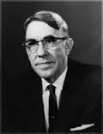
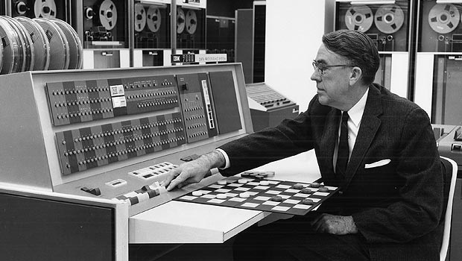
What is Machine Learning?
Arthur Samuel
(1901-1990)
– a pioneer of artificial intelligence research
Arthur Samuel’s Checkers program is considered a milestone for artificial intelligence, and offered the public in the early 1960s an example of the capabilities of an electronic computer.

Slide 3

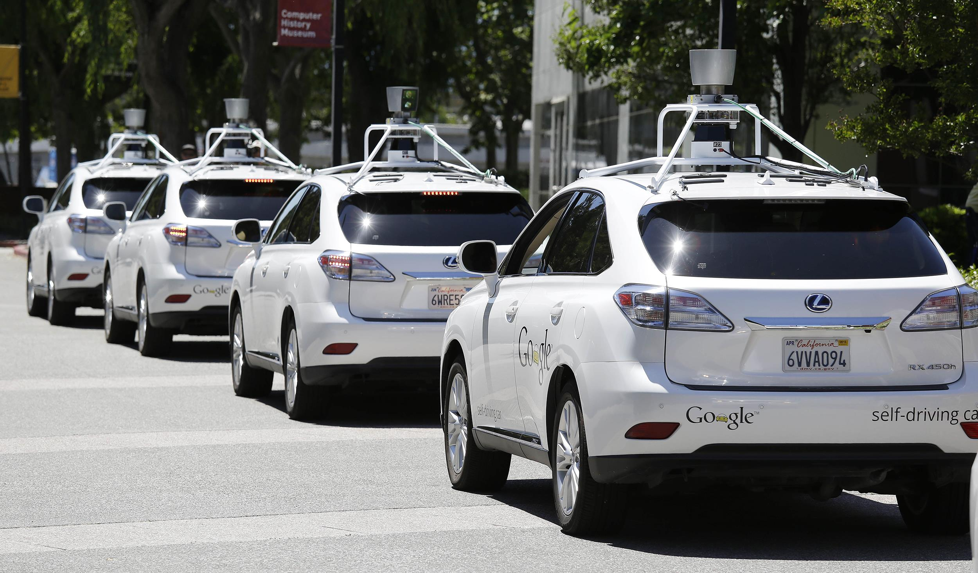

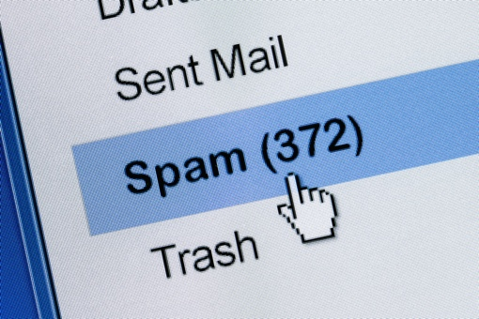
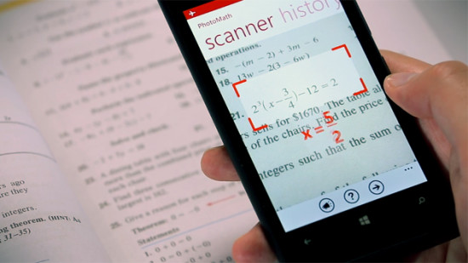
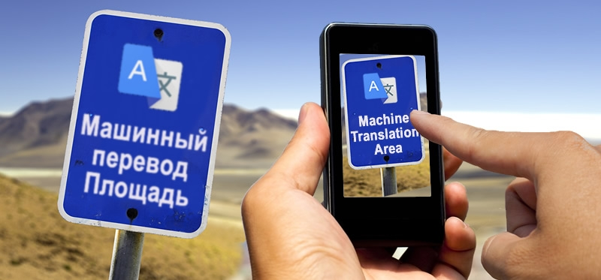
What is Machine Learning?
Examples of machine learning tasks may include:
Recommender systems
Self-driving cars
Image search
[Link]
[Link]
Machine Translation
Spam Filtering
Text Recognition
[Link]
[Link]
[Link]

Slide 4
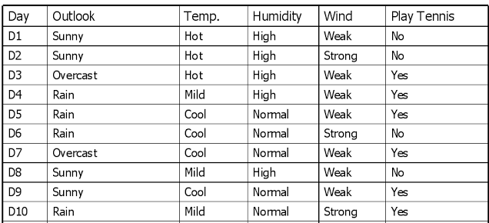

Terminology
Instances (examples, observations)
[Link]
Could you predict the values of “Plat Tennis”?
?
?
?
[Link]

Slide 5
Terminology
Label (class)
Instances (examples, observations)
[Link]
Could you predict the values of “Plat Tennis”?
?
?
?
[Link]

Slide 6
Terminology
Features
Label (class)
Instances (examples, observations)
[Link]
Could you predict the values of “Plat Tennis”?
?
?
?
[Link]

Slide 7
Terminology
Features
Label (class)
Instances (examples, observations)
Training data
[Link]
Could you predict the values of “Plat Tennis”?
?
?
?
[Link]

Slide 8
Terminology
Features
Label (class)
Instances (examples, observations)
Training data
[Link]
Could you predict the values of “Plat Tennis”?
?
?
Testing data
?
[Link]

Slide 9
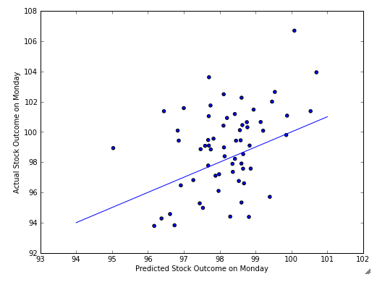
Terminology
Supervised Machine Learning
– learning from labeled data
Unsupervised Machine Learning
– learning from unlabeled data
What is being learned?
– a hypothesis, i.e. parameters of a model that can make accurate predictions (e.g., stock prices)
[Link]

Slide 10
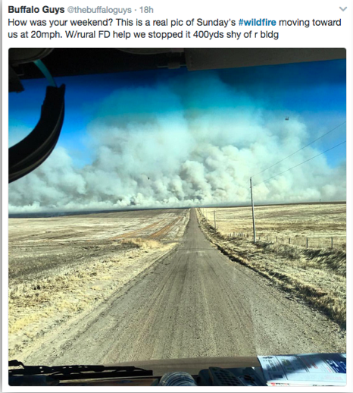
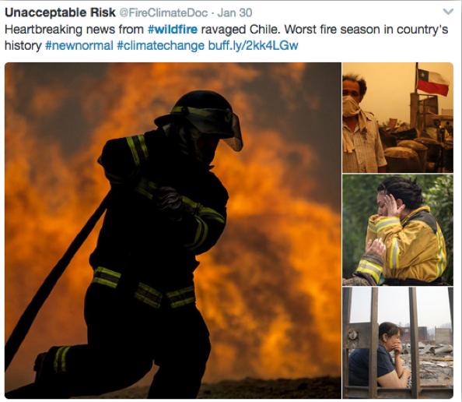
Twitter for Disaster Management

Slide 11
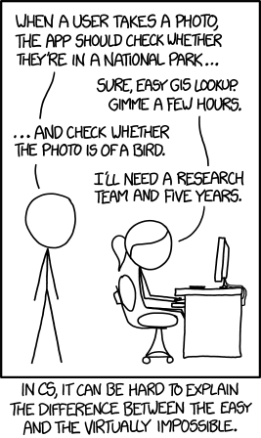
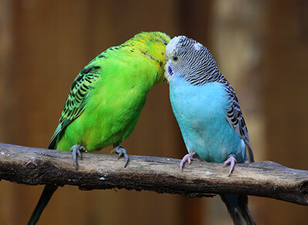
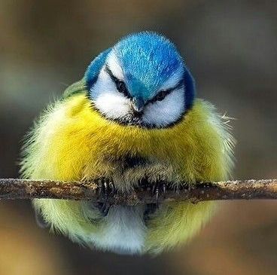
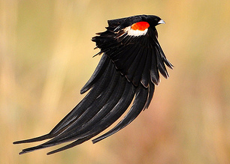
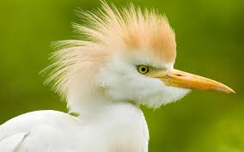
Motivation for Machine Learning
Some tasks are difficult to define algorithmically
Example: is there a bird in a given picture?

Slide 12



Motivation for Machine Learning
Human language is ambiguous
Could you come up with a general rule to tell which tweets are about natural disasters?

Slide 13
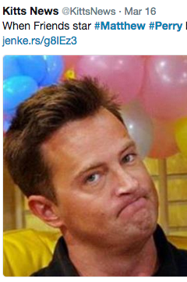
Motivation for Machine Learning
Human language is ambiguous
Using hashtags?
– not too reliable

Slide 14
Supervised Learning Model Workflow
Step 1: Collecting, cleaning, preprocessing of data (training data)
Feature Extraction
Preprocessed Data, Labels
Raw Data, Labels

Slide 15
Supervised Learning Model Workflow
Step 2: Training a machine learning model
Preprocessed Data, Labels
Machine Learning Algorithm
Feed the data
Trained Machine Learning Model

Slide 16
Supervised Learning Model Workflow
Step 3.1: Preprocessing of unseen data (testing data)
Feature Extraction
Preprocessed Unseen Data
Unseen Raw Data

Slide 17
Supervised Learning Model Workflow
Step 3.2 : Predicting output on unseen data (testing data)
Trained Machine Learning Model
Preprocessed Unseen Data
Feed the data
Output
(i.e. predicted labels)

Slide 18
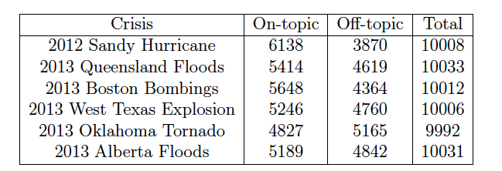
Data Description
Original dataset:
60,000 tweets posted during 6 crisis events in 2012 and 2013

Slide 19
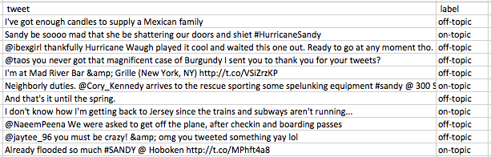
Data Description
Original tweets:

Slide 20
Data Preprocessing
Original tweets:
“@ibexgirl thankfully Hurricane Waugh played it cool”
“I'm at Mad River Bar &amp; Grille (New York, NY) http://t.co/VSzKP”
Preprocessed tweets:
“USERNAME thankfully Hurricane Waugh played it cool”
“I'm at Mad River Bar & Grille (New York, NY) URL”

Slide 21
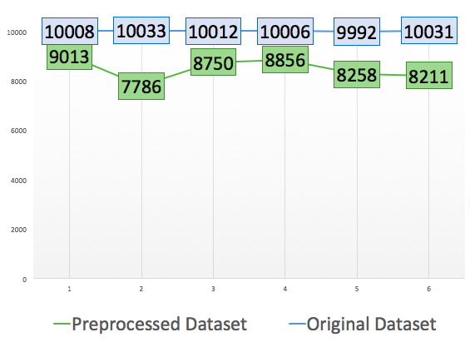
Data Description
Number of samples
Disasters

Slide 22
Supervised Machine Learning
assumes that training and testing data come from the same distribution

Slide 23
Domain Adaptation Terminology
Previous disaster – “Source”
Current disaster – “Target”
Labels are available
No labels are available

Slide 24
Motivation for Domain Adaptation

Slide 25
Problem Definition
learn a model from labeled source data and unlabeled target data:
Labeled Source Data
Unlabeled Target Data
Machine Learning Model

Slide 26
Single-source Domain Adaptation

Slide 27
Correlation Alignment Algorithm

Slide 28
Feature Selection

Slide 29
Naive Bayes Classifier

Slide 30
Experiments

Slide 31
Results

Slide 32
Multi-source Domain Adaptation

Slide 33
Experiments

Slide 34
Results

